Slide 1
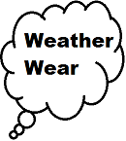
Don’t get caught wearing flip-flops on a rainy day !!
CS639
Petergail McFayden

Slide 2
Who is this app for?
Everyone who goes outside
Any one who finds themselves carrying a umbrella on a sunny day
People who get caught

Slide 3
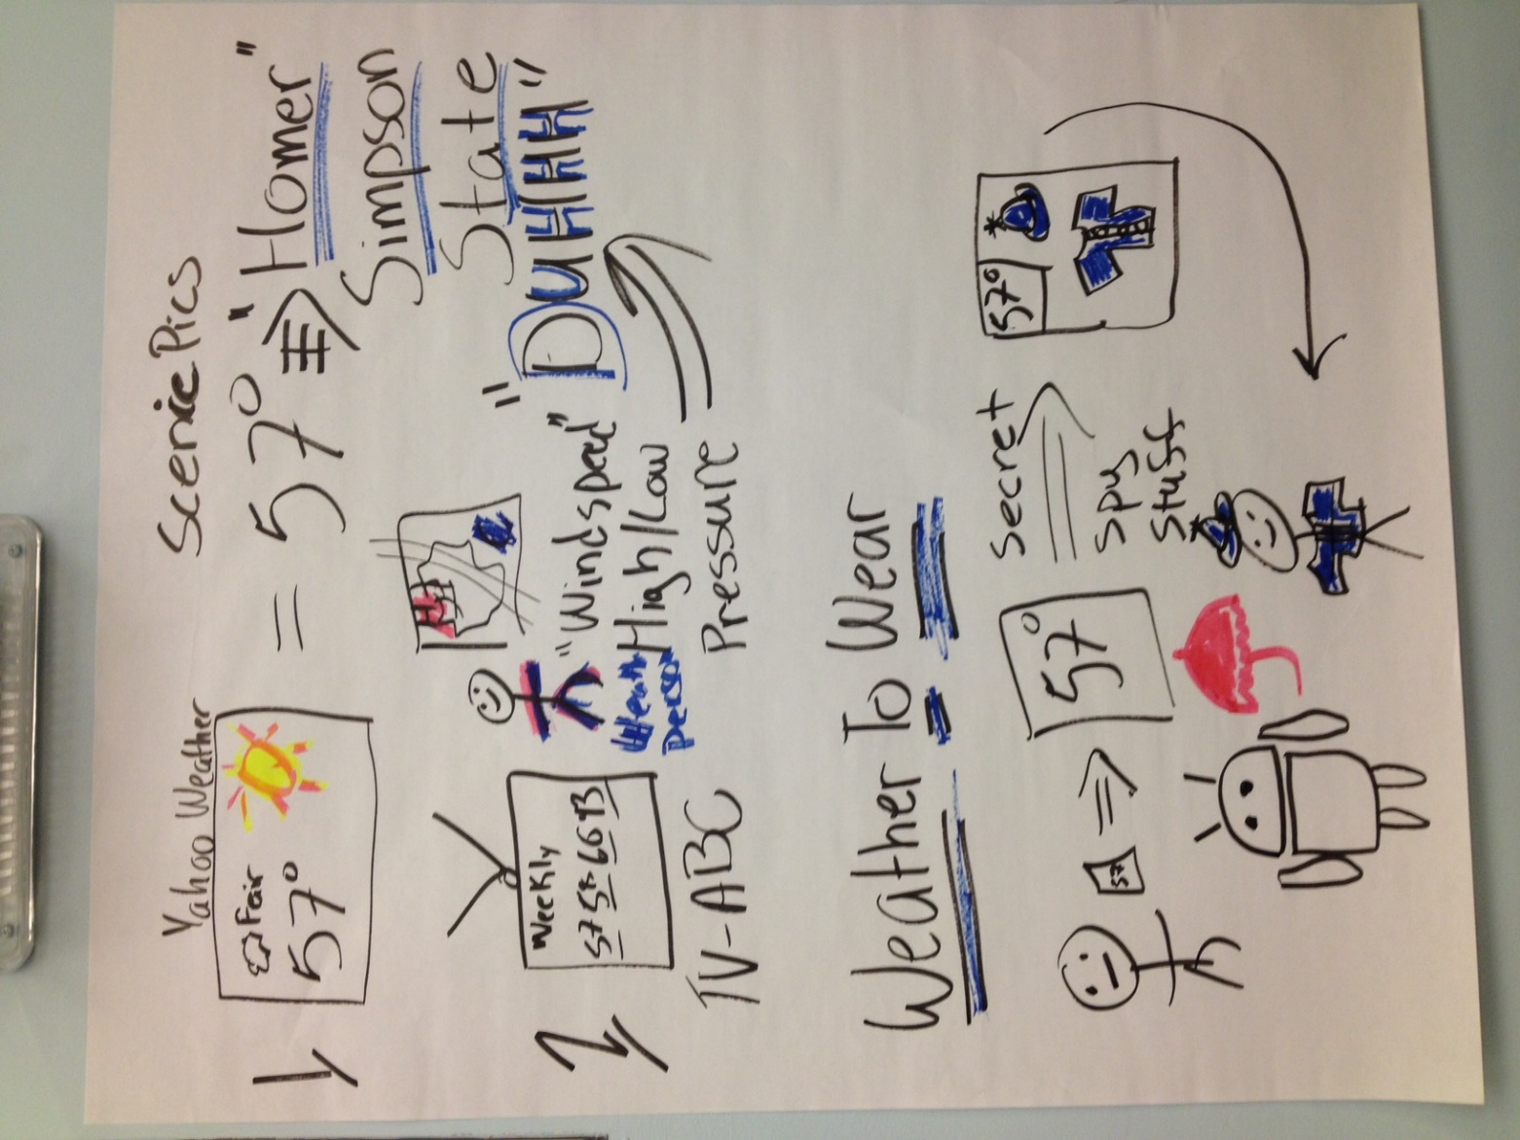
Concept Board
Create an application that would give a visual display of weather recommendations
Imager is based of no clothing and accessory item recommendations
Minimize user input

Slide 4
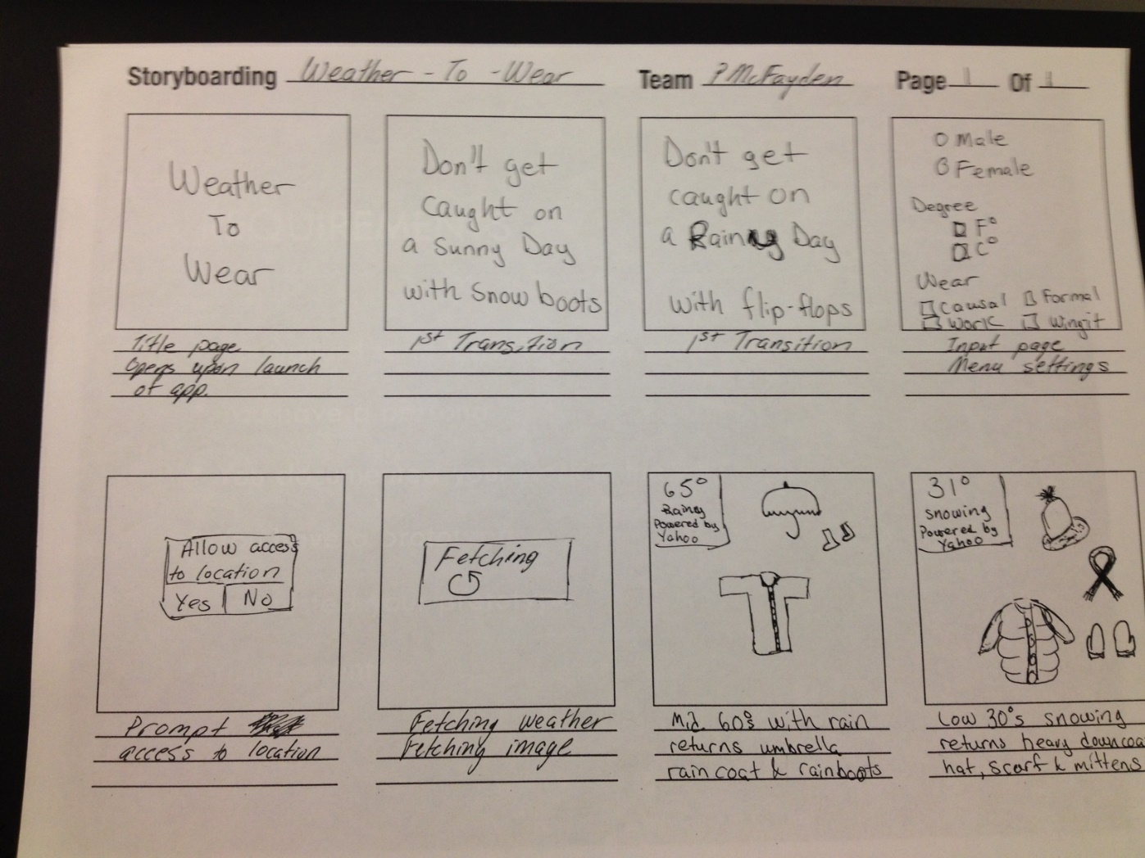
Story Board

Slide 5
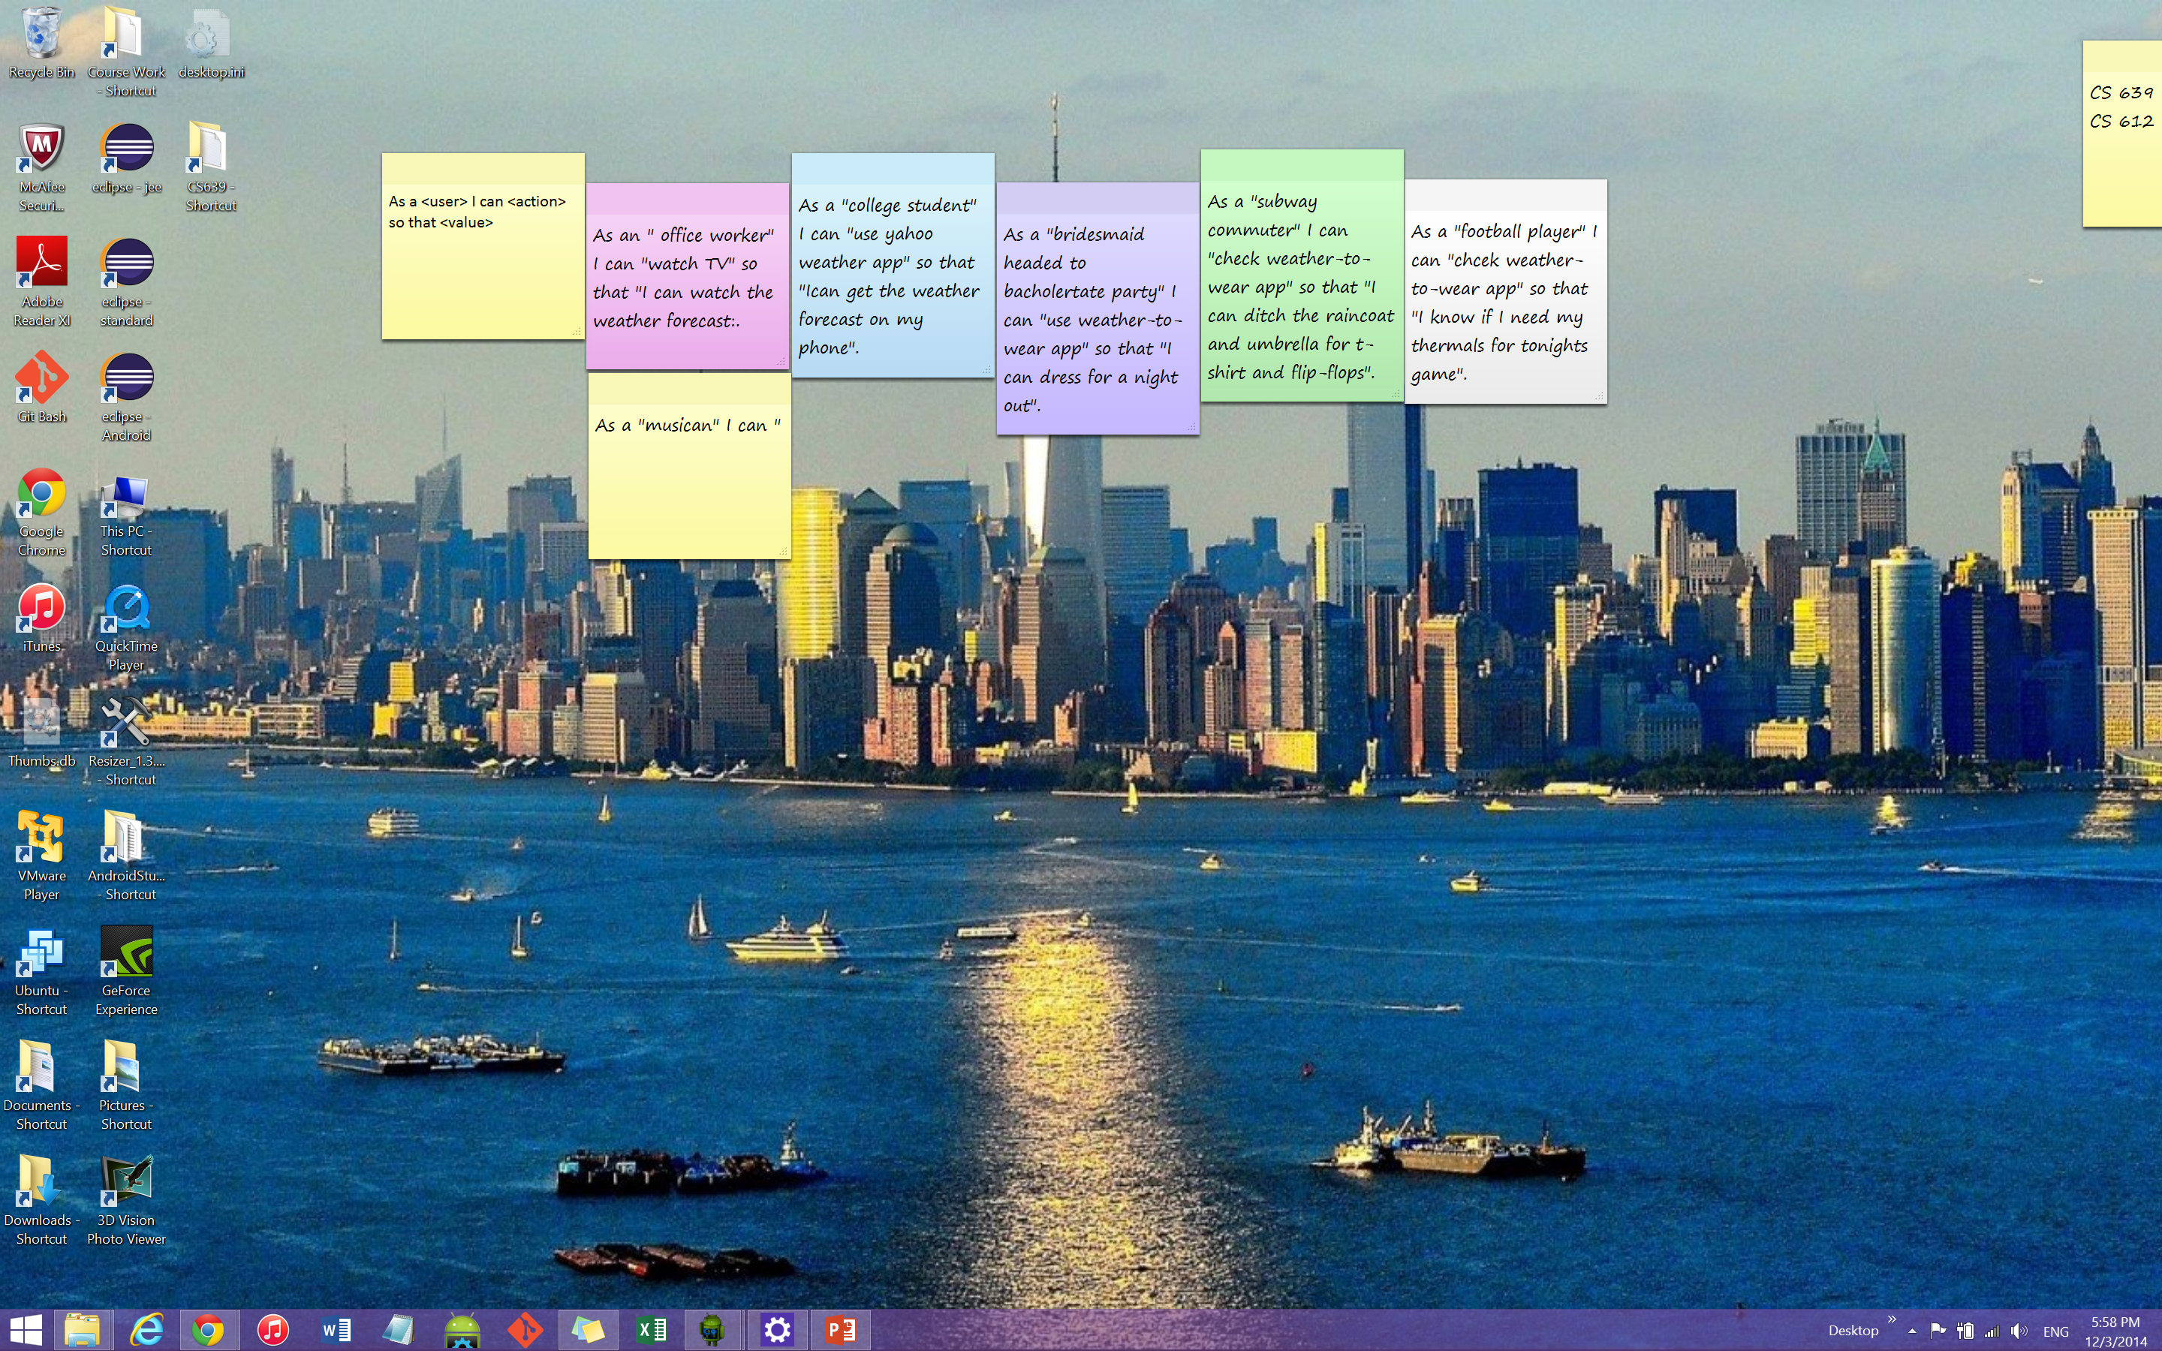
Post Its

Slide 6
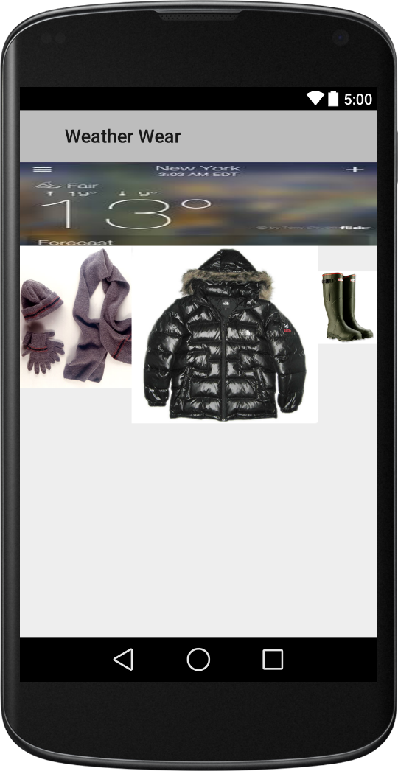
Rough Draft

Slide 7

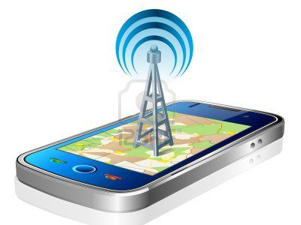
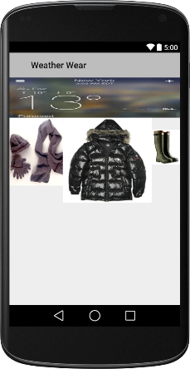
DATA follow
Using the GPS location to draw the network latitude and longitude of the user position.
Queries the weather from the website “Weather Underground”
Parse the return JSON query for the current forecast

Slide 8
Stages of development hurdles
Addressing how generate users location for accurate weather forecast
Access the mobile devices GPS
Still working the bugs out of that
Hard cord the location from a user interface
Trying to minimize user input, will use as last resort
Choosing reliable online weather source
Yahoo Weather API
Connecting to Yahoo Weather API
Got that figured out
Working on the location issue, in order to pull current forecast
Visual Basic
Make it look appealing to broad audience
Have to overlay the wear imagery over the weather image

Slide 9
Updates since last post
Addressing how generate users location for accurate weather forecast
Access the mobile devices GPS
Current device is not on network so issues grabbing GPS
Hard cord the location from a user interface
Trying to minimize user input, will use as last resort
Choosing reliable online weather source
Yahoo Weather API – stop supporting their weather api
Switched to Weather Underground
Connecting to Weather Underground API
Sending a simple query by way of http “GET” request
Returns a JSON request set
Visual Basic
Make it look appealing to broad audience
Have to overlay the wear imagery over the weather image

Slide 10
JSON Query Result that Needs to be Parse, pg 1/3
"display_location": {
"full": "San Francisco, CA",
"city": "San Francisco",
"state": "CA",
"state_name": "California",
"country": "US",
"country_iso3166": "US",
"zip": "94101",
"latitude": "37.77500916",
"longitude": "-122.41825867",
"elevation": "47.00000000"
},
"observation_location": {
"full": "SOMA - Near Van Ness, San Francisco, California",
"city": "SOMA - Near Van Ness, San Francisco",
"state": "California",
"country": "US",
"country_iso3166": "US",
"latitude": "37.773285",
"longitude": "-122.417725",
"elevation": "49 ft"
},
"estimated": {},
"station_id": "KCASANFR58",
"observation_time": "Last Updated on June 27, 5:27 PM PDT",
"observation_time_rfc822": "Wed, 27 Jun 2012 17:27:13 -0700",
"observation_epoch": "1340843233",
"local_time_rfc822": "Wed, 27 Jun 2012 17:27:14 -0700",
"local_epoch": "1340843234",
"local_tz_short": "PDT",
"local_tz_long": "America/Los_Angeles",
"local_tz_offset": "-0700",
"weather": "Partly Cloudy",
"temperature_string": "66.3 F (19.1 C)",
"temp_f": 66.3,
"temp_c": 19.1,
"relative_humidity": "65%",

Slide 11
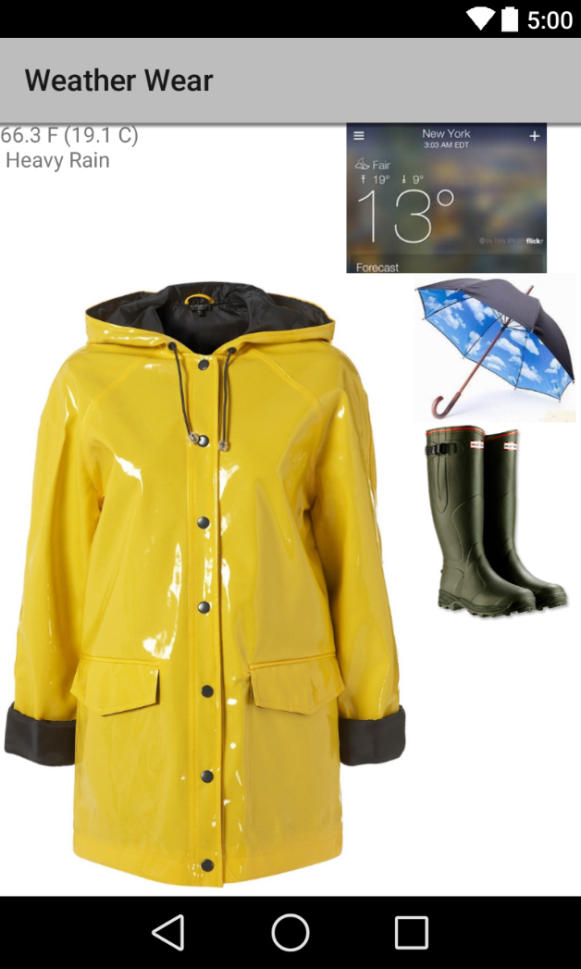
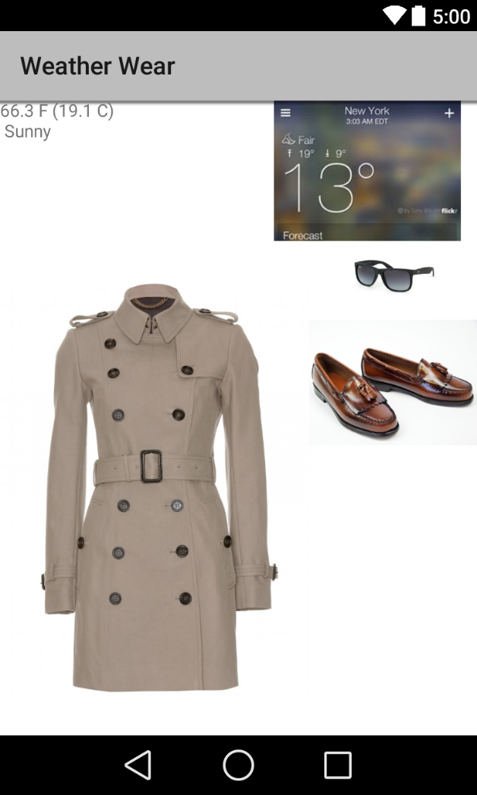
Screenshots

Slide 12
Setbacks
JSON – JSON – JSON –JSON - JSON
Thread heavy due to web dependence

Slide 13
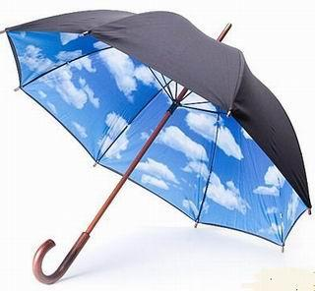
Future
Continue with the app improve the visual
Add a notification that flashes the current temp and image
Eg. Rainday notice – 65 F, windy with rain

